Slide 1

Medical Microbiology Third stage- College of Dentistry
The Microscope
Leb. 2
Prepared by
PhD Dheyaa Naji Hamza
M.Sc. Zainab Majid Mohammed
alkafeel.edu.iq
info@alkafeel.edu.i
1

Slide 2

Learning Objectives
Identify different types of microscopes.
Describe the components of a light microscope.
Demonstrate proper use of a microscope.

Slide 3
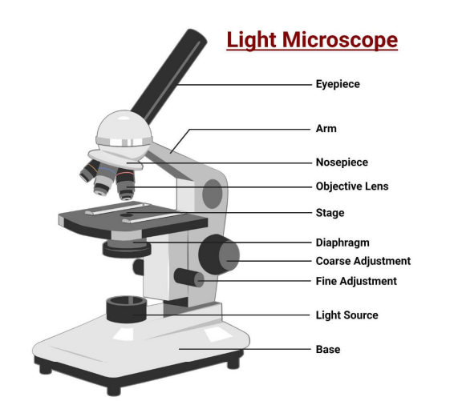
The Microscope:-
Microscope:
is an instrument used to observe objects that are too small to be seen with the naked eye.
Microscopic:
The word comes from “micro”, meaning very small, and “scope”, meaning to look at.

Slide 4
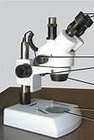
There are several types of microscope:
1-Electron Microscope:
A-Transmission Electron Microscope (TEM(
B-Scanning Electron Microscope (SEM(
2-Fluorescence Microscope:
A-Confocal Microscope
B-Atomic Force Microscope (AFM(
C-Digital Microscope
3-Light Microscope:
A- Compound Microscope
B- Stereo microscope
alkafeel.edu.iq
info@alkafeel.edu.i

Slide 5
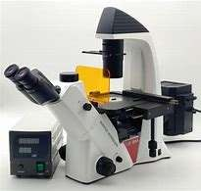
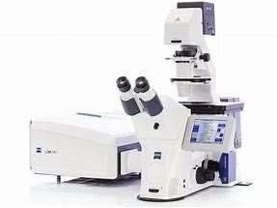
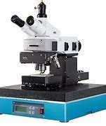
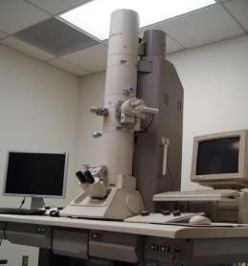
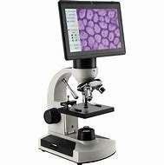
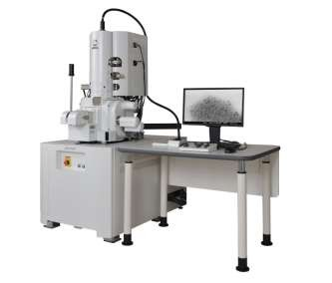
Confocal Microscope
Fluorescence Microscope
Atomic Force Microscope (AFM)
Transmission Electron Microscope (TEM(
Scanning Electron Microscope (SEM
Digital Microscope
alkafeel.edu.iq
info@alkafeel.edu.i

Slide 6
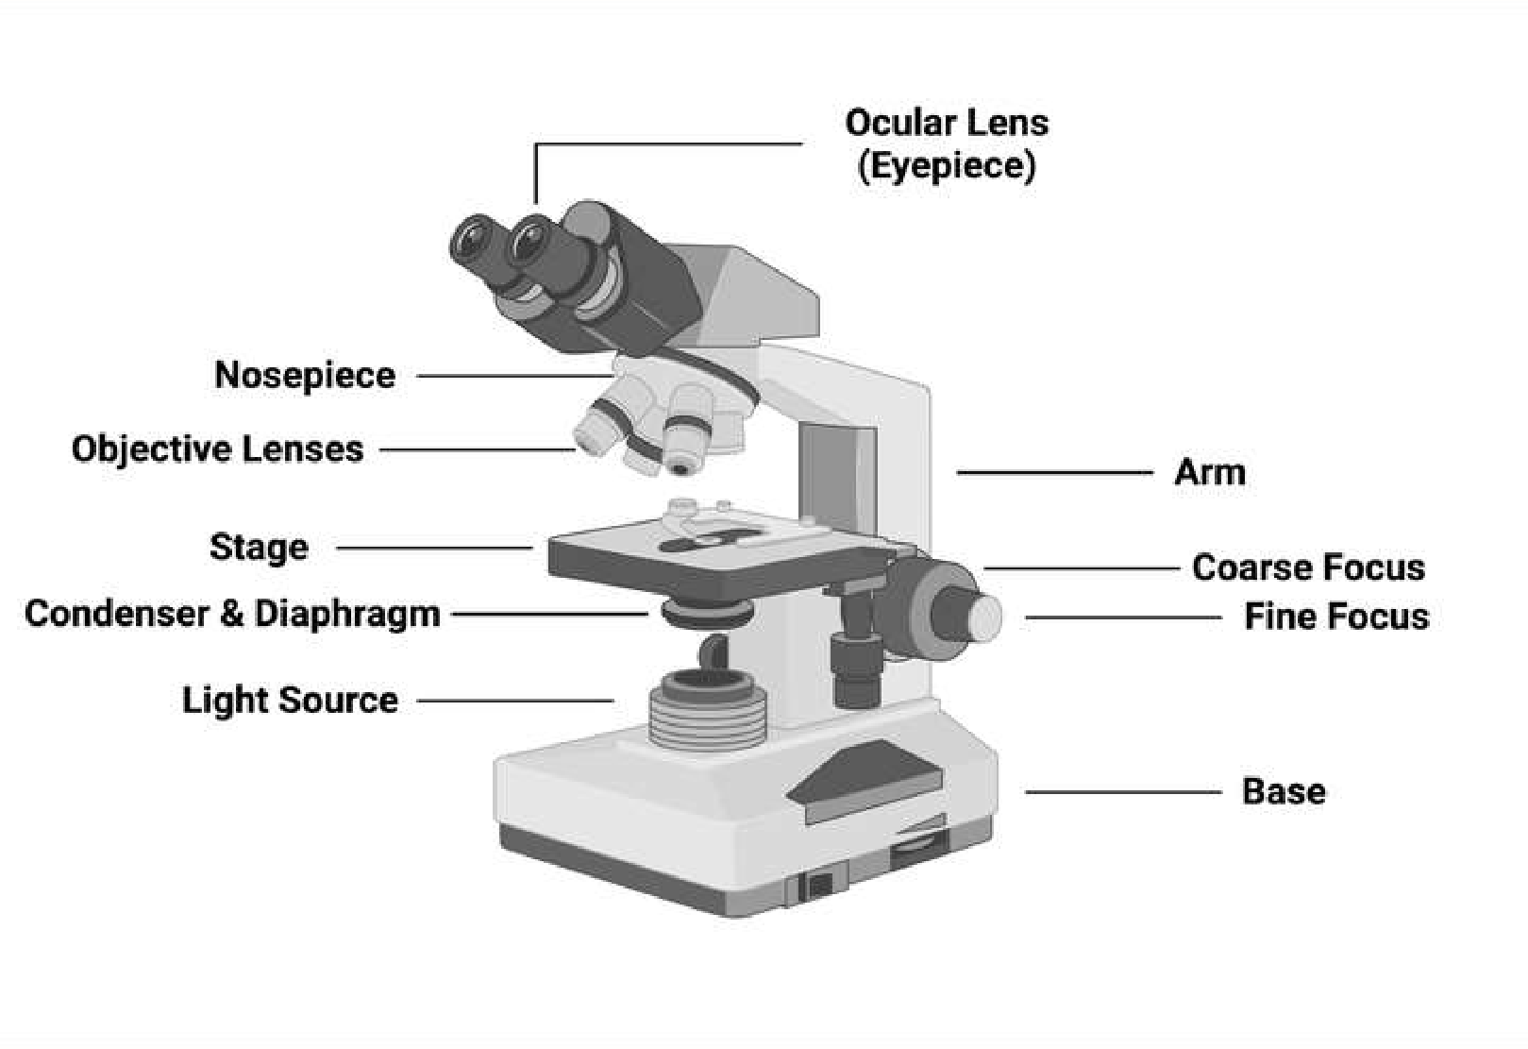
Light or Compound Microscope
alkafeel.edu.iq
info@alkafeel.edu.i

Slide 7
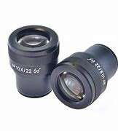
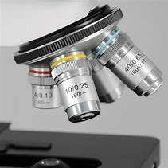
Parts of a Light Microscope:
1.Eyepiece Lens: Magnifies the image and brings it into focus for the viewer.
2. Objective Lenses: Provide different levels of magnification, typically 4×, 10×, 40×, and 100×.
3. Condenser: Focuses light onto the specimen for clearer viewing.
alkafeel.edu.iq
info@alkafeel.edu.i

Slide 8
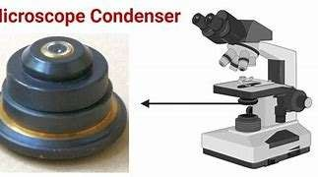
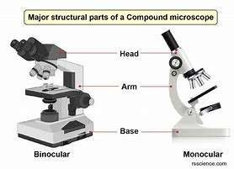
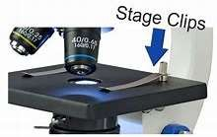
4. Arm: The curved structure that supports and holds all the optical components in place.
5. Base: The bottom part of the microscope that supports its entire weight and provides stability.
6. Stage: The flat platform where the glass slide with the specimen is placed for observation.
7-Stage Clips: holds down the slide on the stage.
alkafeel.edu.iq
info@alkafeel.edu.i

Slide 9
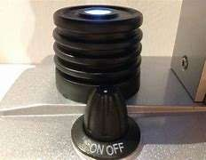
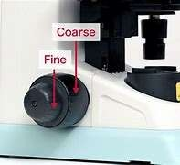
8-Light Source: Higher-quality microscopes have a built-in light source to illuminate the specimen.
9-Focusing Knobs: These knobs adjust the focus by moving the stage up and down. They include coarse adjustment (for general focusing) and fine adjustment
(for precise focusing).
alkafeel.edu.iq
info@alkafeel.edu.i

Slide 10
How to use a microscope:
1-Carrying the Microscope: Hold the microscope by its arm with one hand and support the base with the other.
2. Place the microscope on a table with the arm toward you.
3.Turn the coarse adjustment knob to raise the body tube.
4. Rotate the nosepiece until the low-power objective lens clicks into position.
alkafeel.edu.iq
info@alkafeel.edu.i

Slide 11

Any Question?
Thank you
alkafeel.edu.iq
info@alkafeel.edu.i

